Slide 1
NumPy Introduction
Kenneth Lu
Notes:
Note: I use java the most, so I will make some comparisons to Java, though you don’t have to understand java to understand most of the concepts.
Note: I assume that import numpy as np is used at the top of the code for convenience, so most examples will use np.

Slide 2
Resources for NumPy
W3schools - https://www.w3schools.com/python/numpy_intro.asp
Geeksforgeeks - https://www.geeksforgeeks.org/python-numpy/
Cs231n - https://cs231n.github.io/python-numpy-tutorial/#numpy
Tutorialspoint - https://www.tutorialspoint.com/numpy/numpy_iterating_over_array.htm
Notes:
Note - to make this presentation, i mainly used W3schools, but most of these sites have similar information anyway. I just prefer using W3schools.

Slide 3
NumPy (Numerical Python)
NumPy is a python library used to work with arrays, and can be used for working with linear algebra, fourier transformation, and matrices. The source code for Numpy is in this github repository: https://github.com/numpy/numpy
Notes:
Note: most functions return a new array, of which you can access the values.

Slide 4
What Numpy is used for
Linear algebra and python are often used for machine learning, so the numpy library is often used for machine learning. In python, lists are often used as arrays, but they are slow to use. Numpy uses the ndarray to provide an array that is 50x faster than lists. (Sets, tuples, and dictionaries are different from arrays. Lists are the most similar) Numpy also has multiple functions to help in using the ndarray. Some of the functions were written in c or c++ to enhance the speed. Numpy has functions similar to functions from lists.

Slide 5
Creating numpy arrays
To create a numpy array (ndarray), you use the array function() on numpy.
Example:arr = np.array([1,2,3,4,5])
The array can take in any array-like data type that stores multiple variables (list, tuple). If you want to convert a set or dictionary, you have to convert those to another type.
Ndarrays can have multiple dimensions. A 0-D or scalar can be converted into a ndarray by just putting the value in (np.array(24)). A normal 1-D array is created like shown above. A 2-D array or matrix is just made up of multiple 1-D arrays (np.array([[1,2,3],[4,5,6]])). 3-D arrays are made of 2-D arrays (np.array([[[1, 2, 3], [4, 5, 6]], [[1, 2, 3], [4, 5, 6]]])). Higher dimensional arrays work similarly. You can use the ndim attribute to check the number of dimensions(arr.ndim). You can also specify the amount of dimensions(np.array([1,2,3,4,5]), ndim=5))

Slide 6
Array Indexing
Ndarrays follow standard array indexing with an array of n elements being numbered from 0 to n-1. To get an element is also pretty similar. For example, the first element is arr[0]. To access higher dimension arrays, you follow up the first number with commas. Arr[0,1] and arr[0,1,2] could be used for 2 and 3-D arrays. You can also count starting from the end by using negatives. For example: arr[1,-1] would get the 2nd element of a 2d array, and the last element from that element.
Notes:
Note: the indexing and getting a value from a 1-d array is the same as java, but java has multiple brackets instead of colons.

Slide 7
Numpy array slicing
Slicing is taking elements from one index to another. The general arrangement is [start:end:step] (If you don’t include start, step or end, start’s considered 0, step is considered 1, and end is considered the length of the array). For example, arr[1:5] would be the 1st to 5th (2nd to 6th) elements from the array, and the start is included but the end is excluded. Arr[4:] would slice elements from 4 to the end of the array. Arr[:4] would slice elements from the beginning to index 4. You can use negative numbers to slice numbers from the end. Arr[-3:-1] would slice numbers from 3 away from the end to 1 away from the end(the last value). The step value determines which values to skip. For example, arr[1:5:2] would get 1,3,5 instead of 1,2,3,4,5 from step 1. Arr[::2] would get every other element from the array. To splice 2-D arrays, you identify which elements to splice from on both dimensions. For example, arr[1, 1:4] would get elements from index 1 to 4 on the index 1 array. Arr[0:2,2] would get index 2 from elements from index 0 to 2.
Notes:
Note: slicing is similar to java subsets.

Slide 8
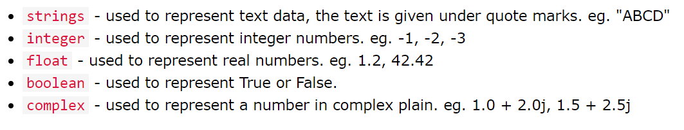
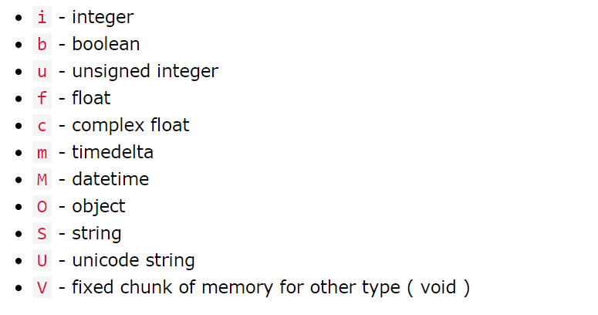
Numpy data types
Numpy has a few more data types that can be used with ndarray than standard python. Each of these are represented by a single character. When creating an array, this can be specified using dtype (np.array([1,2,3,4], dtype=’S’) would make the array a String array instead of an int array).

Slide 9
Array copy vs. view
The difference is that copy will make a completely new array that has no connection to the first one. View will make an array that is connected to the first, so that any change to the first or new array will change the other. To make a copy, you could do x = arr.copy(), while to make a view, you could do x = arr.view(). You can check if another array owns the data of the current array by using the base attribute. The base of a copy is none, while the base of a view is the original array (x.base).

Slide 10
Array shape & reshaping
The shape of an array is the number of elements in each dimension. Numpy arrays have an attribute called shape which will return a tuple with each index having the number of corresponding elements. For example, for arr = np.array([[1, 2, 3, 4], [5, 6, 7, 8]]), arr.shape would return (2,4) for 2 elements in the 2nd dimension, and 4 elements in every element for the first dimension. You can also reshape or change the shape of an array to add or remove dimensions from it (You have to reshape the array to something valid. You can’t reshape an array with 8 elements into a 3x3). For example, if you had an array with 12 elements, you could do newarr = arr.reshape(4,3) to reshape the elements.

Slide 11
Array Iteration
Array iteration is going through all the elements of the arrays one by one. To iterate through the objects of an array, you can use a for loop, such as
Arr = np.array([1,2,3])
For x in arr:
print(x)
You can then nest loops on top of each other to go through each value in a 2-D array. Numpy has a function called nditer() that can make iteration easier. Nditer can allow for: iterating each scalar element, iterating array with different data types, iterating with different step size, and enumerated iteration.
Notes:
2-D array nesting:
For x in arr:
For y in x:
print(y)

Slide 12
Array Iteration cont.
nditer() can be used to get all the scalar elements in a multidimensional array. If arr, is a 3-d array,
For x in np.nditer(arr): print(x)
will print all the individual values of the array. Will iterating an array, op_dtypes can be used with nditer() to change the type of the elements being iterated.
For x in np.nditer(arr, flags=[‘buffered’], op_dtypes[‘S’]):
Will change the values of the array into a string while iterating. You can skip certain values or only iterate certain values using np.nditer.
For x in np.nditer(arr[:, ::2]):
Will skip every other element by implementing only the step.
Notes:
Note: flags=[‘buffered’] was required to use op_dtypes.

Slide 13
Array Iteration cont.
The ndenumerate() method can be used to mention the sequence number of an array.
Arr = np.array([1,2,3])
For idx, x in np.ndenumerate(arr):
print(idx,x)
Will print (0,) 1 (1,) 2,...
If the array was a 2d array with [[1,2,3],[4,5,6]], it would print like (0,0) 1 (0,1) 2 (0,2) 3 (1,0) 4 (1,1) 5 (1,2) 6

Slide 14
Array Joining
Joining arrays is putting the elements of two arrays into one array. We put the arrays that we want to join in the concatenate() function, with the axis (axis is 0 if not defined). For example: np.concatenate((arr1, arr2)) will add all the elements of the two arrays. If we want to join a 2d array by row, we use axis 1 (np.concatenate((arr1, arr2), axis=1). If we had [[1,2],[3,4]] and [[5,6],[7,8]], it would become [[1,2,5,6],[3,4,7,8]]. Stacking is similar to concatenation, but it’s done on a new axis. The function parameters are the same. If we had the arrays [1,2,3] and [4,5,6], which were concatenated on axis 1, it would become [[1,2],[3,4],[5,6]]. Hstack() stacks on rows and vstack() stacks along columns. dstack() stacks along height/depth. The earlier example would become [[[1,4],[2,5],[3,6]]] if vstack was used.
Notes:
We finished here last time.

Slide 15
Array Splitting
Splitting reverses joining, and breaks one array into multiple. To split an array, you use array_split(). For example, if you had the array np.array([1,2,3,4,5,6]), you could split it using np.array_split(arr,3). This would give you [[1,2],[3,4],[5,6]]. The split function also adjusts the end of the newly created array. If the previous example had np.array_split(arr,4), you would get [[1,2],[3,4],[5],[6]]. You do the same thing with two-d arrays, giving the function the array, and amount of splits. Similarly to joining, you can split along a certain axis by providing the axis variable (np.array_split(arr,3,axis=1)). There is also hsplit(), vsplit(), and dsplit()
Notes:
Row, column, and depth

Slide 16
Array Search
To search for a certain value in the array, you use the where() function. For example, if there was the array np.array([1,2,3,4,5,4,4]), x = np.where(arr==4) would return the tuple (3,5,6). np.where(arr%2==0) would give all even values. The function searchsorted() can be used on a sorted array, where it would return where the values should be inserted to maintain sort order. For example, given np.array([6,7,8,9]), np.searchsorted(arr, 7) would give 1. You can also include the side to start sorting from using the side parameter, and setting it to ‘right’. You could also use a list to find where each value of the list would be inserted (np.searchsorted(arr, [2,4,6]) would give [1,2,3] for [1,3,5,9]).

Slide 17
Array Sorting
You can use the sort() function to put elements in an ordered sequence. You use it like: np.sort(arr). It can sort arrays of numbers, strings, and booleans. If a multidimensional array is given, the 1-D arrays will be sorted.
Notes:
Sort gives a new array.

Slide 18
Array Filtering
Filtering an array is creating a new array with some of the old values. You filter the values using a boolean list. For example, given np.array([41,42,43,44]) and x = [True, False, True, False], you could use newarr = arr[x] to have newarr = [41,43]. Filtering is often done based on the original array, and the filter array is usually created from the original array.

Slide 19
Random & Ufunc
I won’t cover these in detail for the sake of time, but Numpy has random and ufunc as well. Random gets a random number (int or float), a random array, or a random value from an array. Ufunc stands for universal function, and are functions that operate on the ndarray. These provide vectorization which is faster than iteration, and additional methods. This includes simple arithmetic, rounding decimals, logs, summations, products, differences, finding gcd/lcm, trigonometric functions, hyperbolic functions, and set operations.

